Slide 1
Coventry Adult Education Service - Information for learners
If you have any questions or concerns – please speak to your tutor
www.coventry.gov.uk/adulted

Slide 2
Useful tips for learners
Welcome to your course with Coventry Adult Education Service - here are some tips to help you with your learning
Your tutor will:
Keep track of how you’re getting on with your course. For example:
Set some time aside at home to practise:
Check what your starting point is when you join the course
Help you decide what you want to achieve from the course
Help identify any additional learning support needs
Give you regular feedback about what’s going well, and how to get the most out of what you’re learning – during the course and at the end
Offer information to support your progression
Get the most out of your course by spending a little time each week practising or finding out more about what you are learning at home. Just a few minutes each day, or a set time each week, will help you to make progress more quickly
Ask your tutor for sources of information to help you practise or develop your knowledge or skills in between classes. They can point you to useful websites, and other sources of information
Join your local library, free of charge, to borrow books or use a computer to help you with your learning
Keep a folder or file of examples of your work, with your own notes
Keep a diary or log of what you’ve learned, and what you need to practise more
Keep photos, videos or audio clips of what you’ve been doing on your course
Let your tutor know how well you’re doing, and what you need more practice with – by discussing your progress with your tutor, or through notes or emails
ask for other learners’ views on your work
If you have any questions or concerns – please speak to your tutor
www.coventry.gov.uk/adulted

Slide 3
What we expect from you
As a learner, you are expected to:
Make a commitment to help yourself to learn and achieve
Come to your classes regularly and arrive on time
Tell your tutor or contact us on 024 7697 5200 if you can’t come to a class or if you’re going to be late
Give us feedback about your course
Behave responsibly and safely
Look after your own belongings (these are your responsibility) and take care of equipment and buildings
Treat other learners, staff and volunteers with respect, whatever their background
Be tolerant of the ideas and opinions of others if they are different from yours
Keep your mobile phone switched off during class
Ask your tutor for permission if you want to distribute any paper-based or electronic information with other learners
If you feel unwell, please don't attend class, call our switchboard on:
024 7697 5200
They will ensure your tutor gets your message
If you have any questions or concerns – please speak to your tutor
www.coventry.gov.uk/adulted

Slide 4
What you can expect from us
You have the right to a good quality service
This will include:
You have a right to information about:
A safe place to learn
Advice and support during your course
Help to achieve your goals
Tutors with skills and experience in the subject you are learning
Tutors who will find out your learning needs
Prompt, regular feedback on your work
Information and advice about what you can do after your course has finished
The chance to give your views about the course
Courses and entry requirements
Qualifications and accreditation
Course fees and help with costs
Your course dates and times
What to do if you can’t attend, if there is an incident, or if you want to complain
A prompt, fair response to any complaint
If you have any questions or concerns – please speak to your tutor
www.coventry.gov.uk/adulted

Slide 5
Using the internet safely
Tips for staying safe online
Be sure who you are dealing with online - people may not be who they say they are!
Don’t open files from people or organisations you don’t know. Beware of ‘phishing’ scams
Don’t share personal information about yourself or others online (including home address, phone number, bank details)
Don’t send a picture of someone else by email or text message without their prior permission
Be aware that any photos, videos or information you put on the internet can be seen by others
If you find any unpleasant or unsuitable material or messages, or anything that makes
you feel uncomfortable when you see it on the internet, please report it straight away to your tutor
Don’t share your username and password or try to use any other person’s username and password
Information on the internet may not be true or accurate. Be careful - it could be a deliberate attempt to mislead you
Coventry Adult Education Service has guidelines on the acceptable use of computers. These are based on the City Council’s policy. These are very important for your own and other people’s safety and security. Please read our guidelines before you use a computer on your course. You can ask your tutor for more information,
or find these guidelines on Coventry Adult Education Service’s virtual learning environment - www.covlearn.co.uk
If you think you are being groomed or bullied online or drawn into any activities that might be illegal (or if you think this is happening to someone you know), tell your tutor or a manager immediately
If you are unhappy or concerned about anything, please report it to your tutor or a member of staff at the centre where you attend your course
Remember, potential employers may search for information about you on social networking sites while they are considering recruitment decisions
If you have any questions or concerns – please speak to your tutor
www.coventry.gov.uk/adulted

Slide 6
Your safety
Your tutor will explain our health and safety procedures to you in your first lesson
We ask you to:
When you hear an alarm:
First Aid
We provide first aid kits at our venues
Follow health and safety procedures and act in a safe way
Follow instructions and use tools and equipment safely
Tell a member of staff about anything you think may be unsafe
Report any accident, incident or near miss to your tutor or another member of staff
Talk to a member of staff straight away if you think you might need help to leave the building in an emergency, so that a personal emergency plan can be agreed at the start of your course
Leave the building with your tutor by the nearest route (the route should be on display In the area in which you are learning)
Do not stay to collect personal items
Your tutor can tell you if there is a first aider on site, and how to contact them
Once the group is outside the building, your tutor will check the register and report to the authorised person on site that everyone has left the building
If there is no first aider on site, the tutor will dial 999 if necessary. If you have an accident on site, you or your tutor will need to fill in an accident form
You should stay outside until your tutor tells you that you can return to the building
If you have any questions or concerns – please speak to your tutor
www.coventry.gov.uk/adulted

Slide 7
Feeling safe
All staff and volunteers in Coventry Adult Education Service take your safety and welfare very seriously
We will:
Follow instructions and use tools and equipment safety
Report any accident, incident or near miss to your tutor or another member of staff
If any of these things are happening to you - or someone you know - please speak to your tutor or a manager in the Coventry Adult Education Service. We will listen and follow procedures to support you
Make sure that you are safe in your class and at the centre where you learn
Respond to any concerns you have about safety
Record and follow up accidents, incidents or near misses
Be safe:
Your safety is very important. You are not safe if you are being:
In an emergency, call 999.
If you are worried that someone you know is being harmed or neglected, you can find more information on:
We ask you to:
harmed or abused
harassed, bullied or exploited
groomed
subjected to radical or extremist views
drawn into extremism or terrorism
Act in a safe way
Be aware of the health and safety of yourself and others
Tell a member of staff about anything you think may be unsafe
Follow health and safety procedures
www.Coventry.gov.uk/safeguarding
or email:
adulted-safeguarding@Coventry.gov.uk
or call a Safeguarding Officer on:
024 7697 6250
If you have any questions or concerns – please speak to your tutor
www.Coventry.gov.uk/adult-education

Slide 8
Democracy
The rule of law
Individual liberty
Mutual respect and tolerance
We believe
in...
Coventry Adult Education Service
promotes British values

Slide 9
What this means:
Democracy means “rule by the people”
Our opinions count
Everyone has the right to vote
Laws and important decisions are made by elected representatives
Democracy
Coventry Adult Education Service
promotes British values

Slide 10
What this means:
Our laws protect all citizens
No one is above the law
We are all innocent until proven guilty
The rule
of law
Coventry Adult Education Service
promotes British values

Slide 11
What this means:
We have the freedom to say what we think
We are free to make choices, so long as we don’t cause harm
No one should force you to act against your will
Individual
liberty
Coventry Adult Education Service
promotes British values

Slide 12
What this means:
Respect is shown to all cultures and backgrounds
No one can be discriminated against because of age, disability, sex, sexual orientation, gender reassignment, marriage and civil partnership, pregnancy
and maternity, race, religion and belief
We show tolerance for all religions and beliefs
Mutual
respect and
tolerance
Coventry Adult Education Service
promotes British values

Slide 13
Additional Learning Support
Do you need extra help on your course with maths, spelling, reading, writing or taking notes?
Help with costs
Discretionary Learner Support Fund
There are limited funds to help learners on some courses who are having financial difficulties.
For example, you might be able to apply to the Discretionary Learner Support fund for help with course fees, examination and accreditation fees, books, equipment or transport.
You can get more information on the fund from your local centre, or you can phone 024 7697 5200
If you have a disability, learning difficulty, hearing or sight impairment, do you need:
individual help?
different teaching materials?
learning aids?
Different kinds of support can help you to take part and achieve your goals. To find out more, please ask your tutor or a manager in the Adult Education Service.
If you have any questions or concerns – please speak to your tutor
www.coventry.gov.uk/adulted

Slide 14
Careers Education Information, Advice and Guidance (CEIAG)
Looking for your first job, an Apprenticeship, getting back to work after redundancy, a career change or long term unemployed? There’s help and advice for you at:
Coventry City Council’s Job Shop provides free
Employability workshops
1-2-1 appointments with a job coach
Money advice including debt and benefit support
CV, application and interview skills support
Direct access to employer vacancies
Monday to Friday, 9.30am (Thursdays 10.30am) to 4.30pm.
Address: West Orchards Way, Coventry, CV1 1QX
Telephone: 024 7678 5740
Email: jobshop@coventry.gov.uk
www.coventry.gov.uk/employment-support
The National Careers Service (NCS)
Provides free, advice and guidance on learning, training and work.
Qualified careers advisers can help with:
Job search and applications
Updating your CV
Interview support
Skills analysis and career planning
To book an appointment with a careers adviser call 0800 100 900 or visit https://nationalcareers.service.gov.uk/
City Council Job Coaches and National Careers Service advisers may visit venues and classes. Your tutor will let you know when they are coming.
If you have any questions or concerns – please speak to your tutor
www.coventry.gov.uk/adulted

Slide 15
Childcare
The Discretionary Learner Support Fund may be able to support with the cost of childcare to reduce barriers to accessing our service
Subject to eligibility, the Fund may support the costs to enable you to access:
The Government’s free nursery places for the early years provision scheme, with the option to find pre school/nursery closer to home or where your siblings may already attend.
0 – 2 yr funding = 15 hours per week
2 – 3 yr funding = 15 hours per week
3 – 4 yr funding = 15-30 hours per week
Your own nursery or childminder place. You would need to apply for financial support to cover the costs. The following website lists Ofsted registered nurseries and childminders within Coventry.
https://cid.coventry.gov.uk/kb5/coventry/directory/family.page?familychannel=2
A place within external nurseries that the Adult Education Service partners with. These are based in the Foleshill or Willenhall areas of the City.
You can get more information on childcare from your tutor, local centre, or you can phone 024 7697 5200​
If you have any questions or concerns – please speak to your tutor
www.coventry.gov.uk/adulted

Slide 16
Essential Skills
We can help you with English, maths, Braille, Digital, and English for Speakers of Other Languages (ESOL)
We provide free*courses and support across Coventry, to help you to:
We also offer Braille, and specialist English and maths classes for blind and visually impaired learners
speak confidently
work with numbers
take and make notes
develop digital skills
spell and use punctuation correctly
read confidently
present your course work
support your children
learn about living in Britain
get a qualification in English, maths, digital or ESOL
For more information speak to your tutor, or
email: adulted-queries@Coventry.gov.uk
or
phone: 024 7697 5200
* Please note some ESOL learners may need to pay for their course
If you have any questions or concerns – please speak to your tutor
www.coventry.gov.uk/adulted

Slide 17
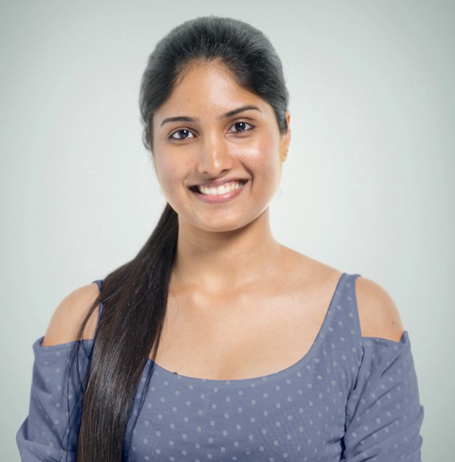
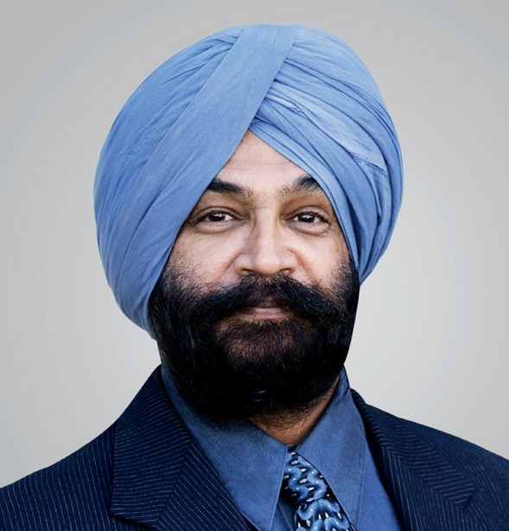
Celebrate diversity
We will provide learning that celebrates our diverse society
Coventry City Council’s Adult Education Service offers a wide range of exciting courses in venues across the city For more information visit our website at www.coventry.gov.uk/adulted or call us on 024 7697 5200

Slide 18
Comments and Suggestions
Let us know what you think! We are keen to hear what you think about your experience with us
What has worked well for you? How do you think we could improve our service?
If you have comments and suggestions, please:
If the problem is still not sorted out, you can use the City Council’s comments, compliments and complaints procedure by doing one of the following:
tell your tutor or the course organiser
email us at adulted-queries@Coventry.gov.uk
phone: 0800 269851
visit the Speak Up website:
Comments, compliments and complaints – Coventry City Council
If you are not happy with your course, please:
tell your tutor or the course organiser
email us at adulted-queries@Coventry.gov.uk
phone Coventry Adult Education Service on 024 7697 5200
write to: Coventry City Council, PO Box 15, Council House, Earl Street, Coventry, CV1 5RR
If you have any questions or concerns – please speak to your tutor
www.coventry.gov.uk/adulted

Slide 19
Privacy and fair processing notices
How we use your personal information
Your personal information is shared with the Department for Education (DfE) including the Education and Skills Funding Agency. The information you provide may also be shared with other organisations. A list of organisations that we share data with can be found on the Adult Education Privacy Notice at www.Coventry.gov.uk/adult-education
You have the right to:
Ask for any information that we hold
Withdraw or change consent in some cases
Ask us to limit the way we use your personal data
Question decisions made about you by computer
Complain to the Information Commissioner’s Office
Have your data transferred to another Authority
To exercise these rights please contact the Management Information Services Team at adulted-queries@Coventry.gov.uk
At the end of your course you may be contacted to establish the difference the course has made to your circumstances.
We will only keep your information for as long as required by law or by our contract of service. The time kept can be different depending on the programme you are on.
Please note the Adult Education privacy Notice should be read in conjunction with the City Council's Privacy Notice.
If you have any questions or concerns – please speak to your tutor
www.coventry.gov.uk/adulted

Slide 20
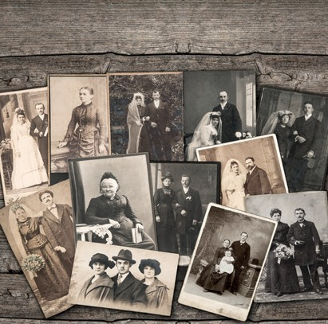
Customer Service | Art | Childcare | Crafts & Textiles | Business Administration | Dance | ESOL
English
Family Learning
Apprenticeships
Maths
Piano
History
Digital Skills
First Aid
Personal Development
Supporting Teaching
Languages
Coventry City Council’s Adult Education Service offers a wide range of exciting courses in venues across the city. For more information visit our website at www.coventry.gov.uk/adulted or call us on 024 7697 5200

